Slide 1
An Introduction to Prefetching
Csaba Andras Moritz
November, 2007
Copyright C A Moritz, Yao Guo, and SSA group

Slide 2
Outline
Introduction
Data Prefetching
  Array prefetching
  Pointer prefetching
Instruction Prefetching
Advanced Techniques
  Energy-aware prefetching
Summary

Slide 3
Why Prefetching?

Slide 4
“Memory Wall”
1000
“Moore’s Law”
CPU
100
Processor-Memory
Performance Gap:
(grows 50% / year)
Performance
10
DRAM
1
1980
1981
1982
1983
1984
1985
1986
1987
1988
1989
1990
1991
1992
1993
1994
1995
1996
1997
1998
1999
2000

Slide 5
Hide the Memory Latency
Many techniques have been proposed to further hide/tolerate the increasing memory latency.
  For example
    Caches
    Locality optimization
    Pipelining
    Out-of-order execution
    Multithreading
Prefetching is one of the well studied techniques to hide memory latency.
  Some prefetching schemes have been adopted in commercial processors.

Slide 6
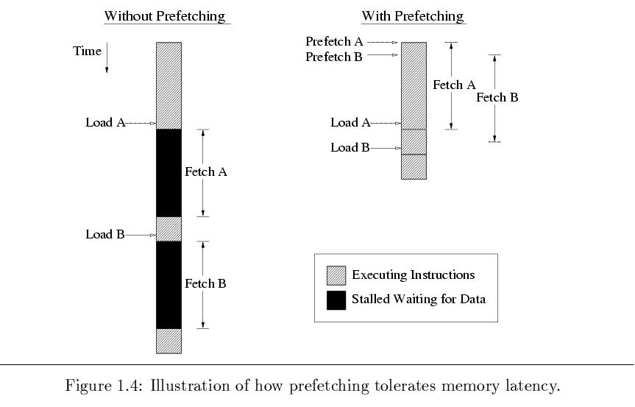
How Prefetching Works?

Slide 7
Prefetching Classification
Various prefetching techniques have been proposed.
  Instruction Prefetching vs. Data Prefetching
  Software-controlled prefetching vs. Hardware-controlled prefetching.
  Data prefetching for different structures in general purpose programs:
    Prefetching for array structures.
    Prefetching for pointer and linked data structures.

Slide 8
Array Prefetching

Slide 9
Basic Questions
When to initiate prefetches?
  Timely
    Too early → replace other useful data (cache pollution) or be replaced before being used
    Too late → cannot hide processor stall
Where to place prefetched data?
  Cache or dedicated buffer
What to be prefetched?

Slide 10
Array Prefetching Approaches
Software-based
  Explicit “fetch” instructions
  Additional instructions executed
Hardware-based
  Special hardware
  Unnecessary prefetchings (w/o compile-time information)

Slide 11
Side Effects and Requirements
Side effects
  Prematurely prefetched blocks → possible “cache pollution”
  Removing processor stall cycles (increase memory request frequency);
  Unnecessary prefetchings → higher demand on memory bandwidth
Requirements
  Timely
  Useful
  Low overhead

Slide 12
Software Data Prefetching
“fetch” instruction
  Non-blocking memory operation
  Cannot cause exceptions (e.g. page faults)
Modest hardware complexity
Challenge -- prefetch scheduling
  Placement of fetch inst relative to the matching load or store inst
  Hand-coded by programmer or automated by compiler

Slide 13
Loop-based Prefetching
Loops of large array calculations
  Common in scientific codes
  Poor cache utilization
  Predictable array referencing patterns
fetch instructions can be placed inside loop bodies s.t. current iteration prefetches data for a future iteration

Slide 14
Example: Vector Product
No prefetching
for (i = 0; i < N; i++) {
sum += a[i]*b[i];
}
Assume each cache block holds 4 elements
→ 2 misses/4 iterations
Simple prefetching
for (i = 0; i < N; i++) {
fetch (&a[i+1]);
fetch (&b[i+1]);
sum += a[i]*b[i];
}
Problem
  Unnecessary prefetch operations

Slide 15
Example: Vector Product (Cont.)
Prefetching + loop unrolling
for (i = 0; i < N; i+=4) {
fetch (&a[i+4]);
fetch (&b[i+4]);
sum += a[i]*b[i];
sum += a[i+1]*b[i+1];
sum += a[i+2]*b[i+2];
sum += a[i+3]*b[i+3];
}
Problem
  First and last iterations
fetch (&sum);
fetch (&a[0]);
fetch (&b[0]);
for (i = 0; i < N-4; i+=4) {
fetch (&a[i+4]);
fetch (&b[i+4]);
sum += a[i]*b[i];
sum += a[i+1]*b[i+1];
sum += a[i+2]*b[i+2];
sum += a[i+3]*b[i+3];
}
for (i = N-4; i < N; i++)
sum = sum + a[i]*b[i];

Slide 16
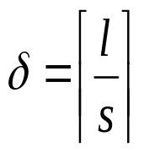
Example: Vector Product (Cont.)
Previous assumption: prefetching 1 iteration ahead is sufficient to hide the memory latency
When loops contain small computational bodies, it may be necessary to initiate prefetches d iterations before the data is referenced
d: prefetch distance, l: avg memory latency, s is the estimated cycle time of the shortest possible execution path through one loop iteration
fetch (&sum);
for (i = 0; i < 12; i += 4){
  fetch (&a[i]);
  fetch (&b[i]);
}
for (i = 0; i < N-12; i += 4){
  fetch(&a[i+12]);
  fetch(&b[i+12]);
  sum = sum + a[i] *b[i];
  sum = sum + a[i+1]*b[i+1];
  sum = sum + a[i+2]*b[i+2];
  sum = sum + a[i+3]*b[i+3];
}
for (i = N-12; i < N; i++)
sum = sum + a[i]*b[i];

Slide 17
Limitation of Software-based Prefetching
Normally restricted to loops with array accesses
Hard for general applications with irregular access patterns
Processor execution overhead
Significant code expansion
Performed statically

Slide 18
Hardware Data Prefetching
No need for programmer or compiler intervention
No changes to existing executables
Take advantage of run-time information
E.g.,
  Alpha 21064 fetches 2 blocks on a miss
  Extra block placed in “stream buffer”
  On miss check stream buffer
Works with data blocks too:
  Jouppi [1990] 1 data stream buffer got 25% misses from 4KB cache; 4 streams got 43%
  Palacharla & Kessler [1994] for scientific programs for 8 streams got 50% to 70% of misses from
  2 64KB, 4-way set associative caches

Slide 19
Sequential Prefetching
Take advantage of spatial locality
One block lookahead (OBL) approach
  Initiate a prefetch for block b+1 when block b is accessed
  Prefetch-on-miss
    Whenever an access for block b results in a cache miss
  Tagged prefetch
    Associates a tag bit with every memory block
    When a block is demand-fetched or a prefetched block is referenced for the first time next block is fetched.
    Used in HP PA7200

Slide 20
OBL Approaches
Prefetch-on-miss
Tagged prefetch
demand-fetched
0
demand-fetched
prefetched
1
prefetched
demand-fetched
prefetched
0
demand-fetched
0
prefetched
1
prefetched

Slide 21
Degree of Prefetching
OBL may not initiate prefetch far enough to avoid processor memory stall
Prefetch K > 1 subsequent blocks
  Additional traffic and cache pollution
Adaptive sequential prefetching
  Vary the value of K during program execution
  High spatial locality → large K value
  Prefetch efficiency metric
  Periodically calculated
  Ratio of useful prefetches to total prefetches

Slide 22
Stream Buffer
K prefetched blocks → FIFO stream buffer
As each buffer entry is referenced
  Move it to cache
  Prefetch a new block to stream buffer
Avoid cache pollution

Slide 23
Stream Buffer Diagram
from processor
to processor
Tags
Data
Direct
mapped
cache
head
tag and
comp
one cache block of data
Stream
buffer
a
tag
one cache block of data
a
tail
tag
one cache block of data
a
Source: Jouppi
ICS’90
tag
one cache block of data
a
+1
Shown with a single stream buffer (way); multiple ways and filter may be used
next level of cache

Slide 24
Sequential Prefetching
Pros:
  No changes to executables
  Simple hardware
Cons:
  Only applies for good spatial locality
  Works poorly for nonsequential accesses
  Unnecessary prefetches for scalars and array accesses with large stride

Slide 25
Prefetching with Arbitrary Strides
Employ special logic to monitor the processor’s address referencing pattern
Detect constant stride array references originating from looping structures
Compare successive addresses used by load or store instructions

Slide 26
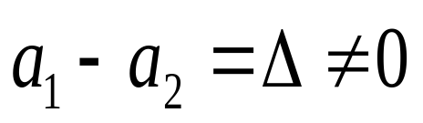
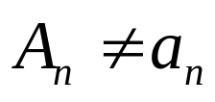
Basic Idea
Assume a memory instruction, m_{i}, references addresses a₁, a₂ and a₃ during three successive loop iterations
Prefetching for m_{i} will be initiated if

Δ: assumed stride of a series of array accesses
The first prefetch address (prediction for a₃)
A₃ = a₂ + Δ
Prefetching continues in this way until

Slide 27
Reference Prediction Table (RPT)
Hold information for the most recently used memory instructions to predict their access pattern
  Address of the memory instruction
  Previous address accessed by the instruction
  Stride value
  State field

Slide 28
Organization of RPT
PC
effective address
-
instruction tag
previous address
stride
state
+
prefetch address

Slide 29
Example
float a[100][100], b[100][100], c[100][100];
...
for (i = 0; i < 100; i++)
for (j = 0; j < 100; j++)
for (k = 0; k < 100; k++)
a[i][j] += b[i][k] * c[k][j];
instruction tag
previous address
stride
state
ld b[i][k]
ld b[i][k]
ld b[i][k]
50000
50004
50008
4
4
0
initial
trans
steady
ld c[k][j]
ld c[k][j]
ld c[k][j]
90000
90400
90800
400
800
0
initial
trans
steady
ld a[i][j]
ld a[i][j]
ld a[i][j]
10000
10000
10000
0
0
0
initial
steady
steady

Slide 30
Software vs. Hardware Prefetching
Software
  Compile-time analysis, schedule fetch instructions within user program
Hardware
  Run-time analysis w/o any compiler or user support
Integration
  e.g. compiler calculates degree of prefetching (K) for a particular reference stream and pass it on to the prefetch hardware.

Slide 31
Integrated Approaches
Gornish and Veidenbaum 1994
  Prefetching Degree is calculated during compiler time.
Zhang and Torrellas 1995
  Compiler generated tags indicate array or pointer structures
  Actual prefetching handled at hardware level

Slide 32
Integrated Approaches – cont.
Prefetch Engine – Chen 1995
  Compiler-feed tag, address and stride information.
  Otherwise, similar to RPT.
Benefits of integrated approaches:
  small instruction overhead
  fewer unnecessary prefetches

Slide 33
Summary – array prefetching
When are prefetches initiated?
  explicit fetch operation (instruction)
  monitoring referencing patterns
Where are prefetched data placed?
  normal cache - binding
  dedicated buffers
What is prefetched?
  Amount of data fetched
  Normally cache blocks

Slide 34
Pointer Prefetching

Slide 35
Prefetching Pointers – Software Approach
Mikko Lipasti ...(Micro’95) - SPAID
Luk & Mowry (TC’99) – Greedy Prefetch
Roth & Sohi (ISCA’99) – Jump Pointers
Chilimbi & Hitzel (PLDI’02) - Hot data Stream
Wu (PLDI’02) – Stride prefetching
Luk (ICS’02) – Profile-based stride pref
Inagaki (PLDI’03) – Dynamic Preftching

Slide 36
Prefetching Pointers – Hardware Approach
Roth & Sohi (ASPLOS’98)
  Dependent based
Cooksey ... (ASPLOS’02)
  Content-directed prefetching
Collins...Tullsen (Micro’02)
  Pointer cache assisted prefetching

Slide 37
Hardware vs. Software Approach
Hardware
Perform. cost: low
Memory traffic: high
History-directed
  could be less effective
Using profiling info.
Software
Perform. cost: high
Memory traffic: low
Better Improvement
Use human knowledge
  inserted by hand

Slide 38
SPAID: (Lipasti Micro’95).
Pointer- and Call-Intensive Programs.
Premise:
  Pointer arguments passed on procedure calls are highly likely to be dereferenced within the called procedure.
SPAID inserts prefetches at call sites for all the pointers passed as arguments.

Slide 39
Greedy Prefetching
Luk & Mowry’s work:
  Chi-Keung Luk and Todd C. Mowry. Compiler-based prefetching for recursive data structures. ASPLOS’96
  Chi-Keung Luk and Todd C. Mowry. Automatic compiler-inserted prefetching for pointer-based applications. IEEE TC’99
Prefetch all the pointers (children) when a node is visited.
  The neighbors have a good chance to be visited sometime in the future even only one pointer is used in traversal.
History-pointer prefetching
  similar to jump pointers

Slide 40
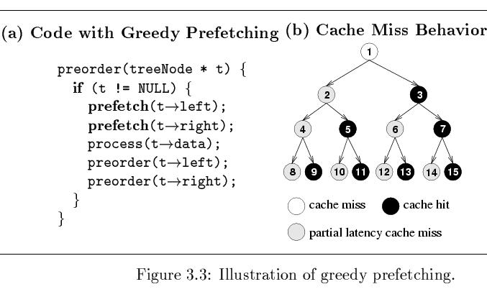
Greedy Prefetching - Example

Slide 41
Example #1
List Traversal
struct t{
stuct t *next,
data value} *p;
while(...){
work(p->data);
p = p->next;
prefetch(p->next);
}

Slide 42
Example #2
Tree traversal
struct t{
stuct t *left,*right;
data value} *p;
foo(struct t *p){
prefetch(p->left);
prefetch(p->right);
work(p->data);
foo(p->left);
foo(p->right);
}

Slide 43
Example #2 (cont.)
Tree traversal
foo(struct t *p){
work(p->data);
temp=p->left;
prefetch(temp->left);
prefetch(temp->right);
foo(temp);
temp=p->right;
prefetch(temp->left);
prefetch(temp->right);
foo(temp);
}

Slide 44
Energy-Aware Prefetching

Slide 45
Power Consumption
Sun’s Surface
10000
1000
Rocket Nozzle
Nuclear Reactor
100
Power Density (W/cm²)
8086
Hot Plate
10
8008
8085
Pentium®
Processors
4004
286
386
8080
486
1
1970
1980
1990
2000
2010
Source: Intel®

Slide 46
Power/Energy
Power consumption is a key constraint in processor designs
  Significant fraction in memory system
  Dynamic power & leakage power
Power/Energy reduction techniques:
  Circuit-level techniques
    CAM tags, asynchronous SRAM cells, word-line gating, etc
  Architecture-level techniques
    Sub-banking, voltage/frequency scaling, etc.
  Compiler-directed energy reduction
    Compiler-managed techniques to reduce switched load capacitances

Slide 47
Data Prefetching & Power/Energy
Most of the prefetching techniques are focused on improving the performance.
How does data prefetching affect power/energy consumption?
Power-consuming components
  Prefetching hardware
    Prefetch history tables
    Control logic
  Extra memory accesses
    Unnecessary prefetching?

Slide 48
Goals
Understand data prefetching and its implications on power/energy consumption.
  Understand performance/power tradeoffs
New energy-aware data prefetching solutions
Approaches
  Reduce unnecessary accesses to hardware
    Energy-aware prefetch filtering
  Improve the power efficiency of prefetch hardware
    Location-set driven data prefetching

Slide 49
Hardware Prefetching Techniques Studied
Prefetching-on-miss (POM)
  Basic sequential prefetching (One Block Lookahead).
Tagged Prefetching - a variation of POM.
  POM + Prefetch when previously prefetched blocks are accessed.
Stride Prefetching [Baer & Chen]
  Effective on array accesses with regular strides
Dependence-based Prefetching [Roth & Sohi]
  Based on relationships between pointers.
Combined Stride and Pointer Prefetching [new]
  Objective to evaluate a technique that would work for all types of memory access patterns

Slide 50
Prefetching Hardware Required
Prefetching Scheme | Hardware Required
Sequential | none
Tagged | 1 bit per cache line
Stride | A 64-entry Reference Prediction Table (RPT)
Dependence | A 64-entry Potential Producer Window (PPW) & a 64-entry Correlation Table (CT)
Combined | All three tables (RPT, PPW, CT)

Slide 51
Prefetching Energy Sources
Prefetching hardware:
  Data (history table) and control logic.
Extra tag-checks in L1 cache
  When a prefetch hits in L1 (no prefetch needed)
Extra memory accesses to L2 Cache
  Due to useless prefetches from L2 to L1.
Extra off-chip memory accesses
  When data cannot be found in the L2 Cache.
Notes:
From the procedure here, we can derive the sources of energy overhead from prefetching.
The first is the extra tag-checks in L1 cache, as we have seen, the L1 cache is checked
for every prefetching request from the prefetch engine before we do the actual prefetching.
We do not actually read the data from L1, the only thing we need is tag lookup.
depends on the different prefetching techniques,

Slide 52
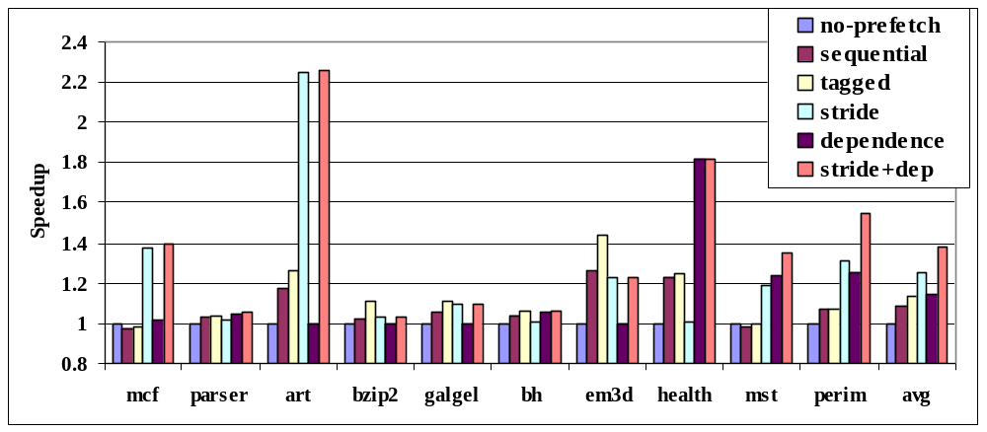
Performance Speedup
Combined (stride+dep) technique has the best speedup for most benchmarks.

Slide 53
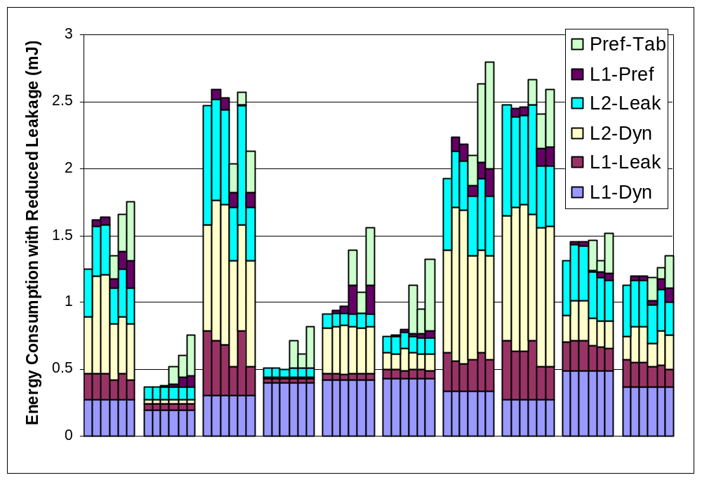
Prefetching Increases Energy!!
NoPrefetch
Sequential
Tagged
Stride
Dependence
Stride+Dep
mcf parser art bzip2 galgel bh em3d health mst perim

Slide 54
Energy-aware hardware prefetching
Energy overhead for hardware prefetching:
  Accesses to the prefetch hardware.
  Extra Tag checks in L1 cache.
Energy-aware hardware prefetching
  Energy-aware prefetch filtering: Reduce # of accesses to power-consuming components.
    Reduce accesses to prefetch history table
    Reduce extra tag checks in L1 cache
  Improve the power efficiency of the prefetch engine.
    Reduce load capacitance switched per prefetch access

Slide 55
Energy-Aware Prefetching Filtering
Compiler-Based Selective Filtering (CBSF)
  Only searching the prefetch hardware tables for selective memory instructions identified by the compiler.
Compiler-Assisted Adaptive Prefetching (CAAP)
  Selectively applying different prefetching schemes depending on predicted access patterns.
Compiler-driven Filtering using Stride Counter (SC)
  Reducing prefetching energy consumption wasted on memory access patterns with very small strides.
Hardware-based Filtering using PFB (PFB)
  Further reducing the L1 cache related energy overhead due to prefetching based on locality with prefetching addresses.

Slide 56
Power-Aware Prefetch Filtering
Compiler-Based Selective Filtering
LDQ RA RB OFFSET Hints
Regular
Cache Access
Filtered
Compiler-Assisted Adaptive Prefetching
Stride Counter
Filtered
Prefetch Filtering using Stride Counter
Stride
Prefetcher
Pointer
Prefetcher
Prefetching Filtering
Buffer (PFB)
Prefetches
Filtered
Tag-array
Data-array
Hardware Filtering using PFB
......
...
...
...
...
L1 D-cache
Prefetch from L2 Cache

Slide 57
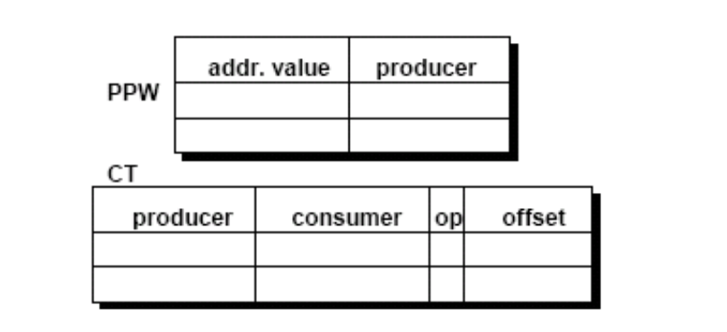
Dependence prefetching
Correlation between loads that produce and address and that consume an address (i.e., dependent) as opposed to same load.
  Linked data structures

Slide 58
Power Dissipation of Hardware Tables
The size of a typical history table is at least 64X64 bits, which is implemented as a fully-associative CAM table.
  Each prefetching access consumes more than 12 mW, which is higher than our low-power cache access.
  Low-power cache design techniques such as sub-banking don’t work.

Slide 59
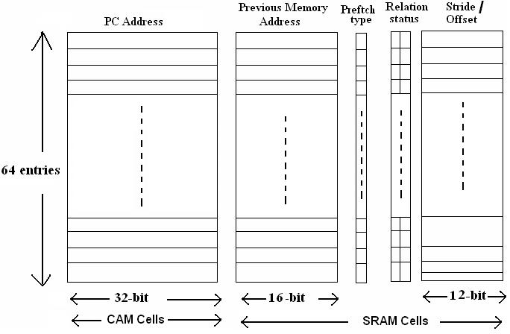
Original Prefetch History Table

Slide 60
How to Reduce Power Dissipation?
PARE - Power-Aware pRefetching Engine.
Two ways to reduce power:
  Reduces the size of each entry.
    Based on spatial locality of memory accesses.
  Partitions the large table into multiple smaller tables, like banking in caches, with compiler help.

Slide 61
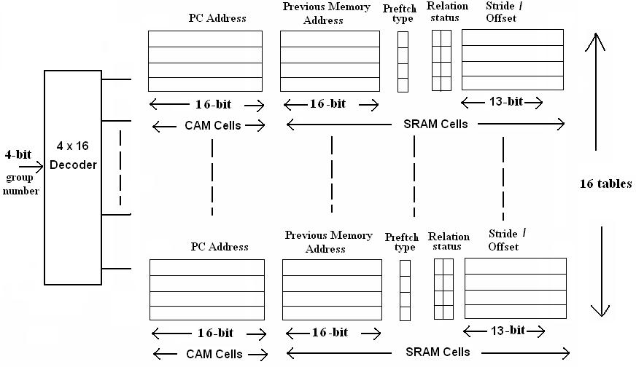
PARE Table Design Overview

Slide 62
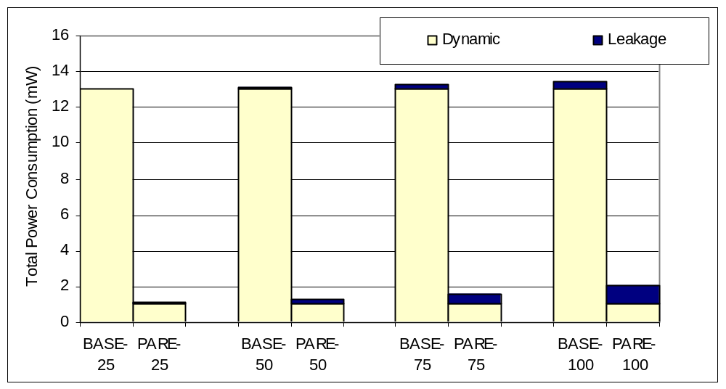
Power Optimization Results
Power is reduced by about 7-11X.
Temperature (C)

Slide 63
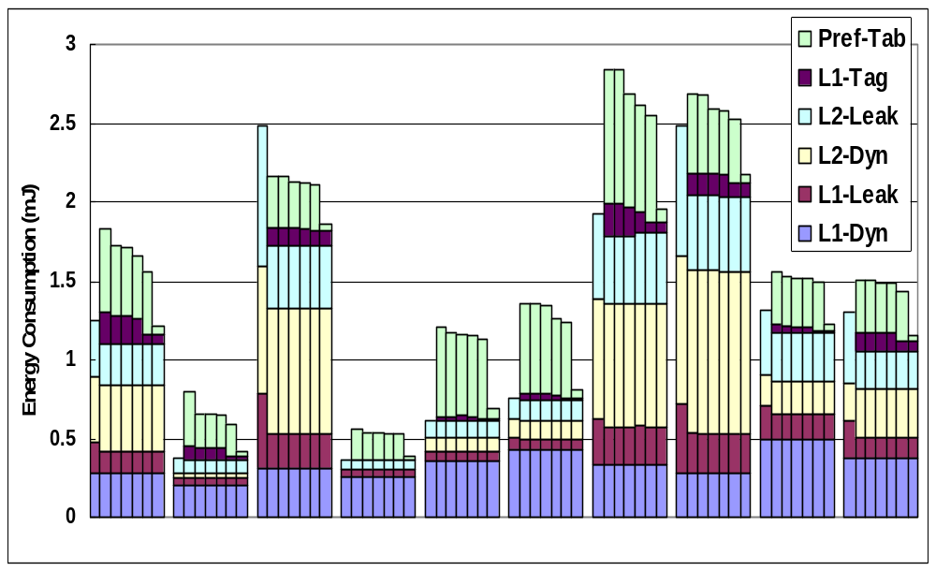
Energy-Saving Results - Combined
NoPrefetch
Stride+Dep
+ CBSF
+ CAAP
+ SC
+ PFB
+ PARE
mcf parser art bzip2 vpr bh em3d health mst perim

Slide 64
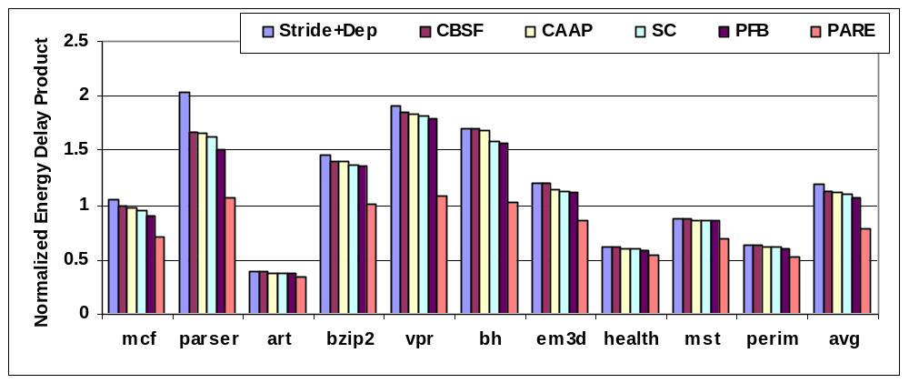
Energy-Delay Product
EDP is improved by 33% compared to the prefetching baseline and 25% compared to no prefetching.

Slide 65
Summary – Power-aware prefetching
Energy-aware data prefetching techniques
  Developed a set of energy-aware filtering techniques
    reduce the unnecessary energy-consuming accesses.
  Developed a location-set data prefetching technique
    uses power-efficient prefetching hardware: PARE.
Proposed techniques could overcome the energy overhead of data prefetching.
  Improve energy-delay product by 33% on average.
  Turn data prefetching into an energy saving technique
  as well as a performance improvement technique.

Slide 66
Backup Material
Instruction prefetching
Pointer prefetching
For energy-aware prefetching read Yao Guo et al papers

Slide 67
Instruction Prefetching

Slide 68
Instruction Prefetching
Next-N-line
  Each fetch also prefetches N sequential cache lines
Target-line
  Predict next line and prefetch it
Wrong-path
  Next-N-line combined with prefetching of lines targeted by static branches
Markov
  Use miss address prediction table to prefetch lines targeted by dynamic branches

Slide 69
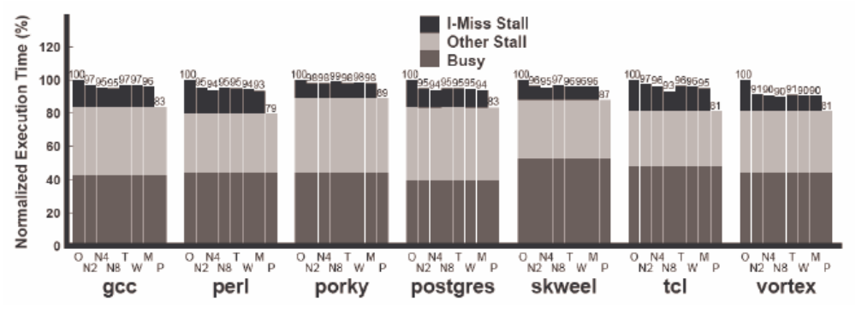
Hardware Prefetching Effectiveness
Why are these schemes not more effective?
Is that an inherent problem with hardware prefetching?

Slide 70
Hardware Mechanisms
Instruction-prefetch instructions
  Compiler provided hints allow prefetching
  Dropped after decode stage (does not ‘execute’)
Prefetch filtering
  Between I-prefetcher and L2 cache
  Reduces the number of useless prefetches
  L2 line counters increment for unused prefetches
  Prefetches are ignored for large counts

Slide 71
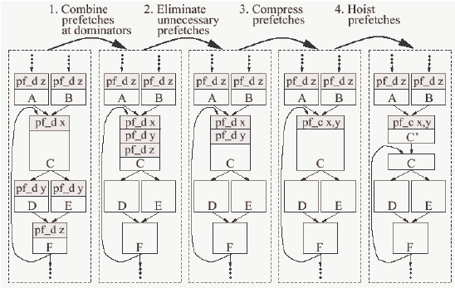
Compiler Support
-Luk & Mowry 12/98

Slide 72
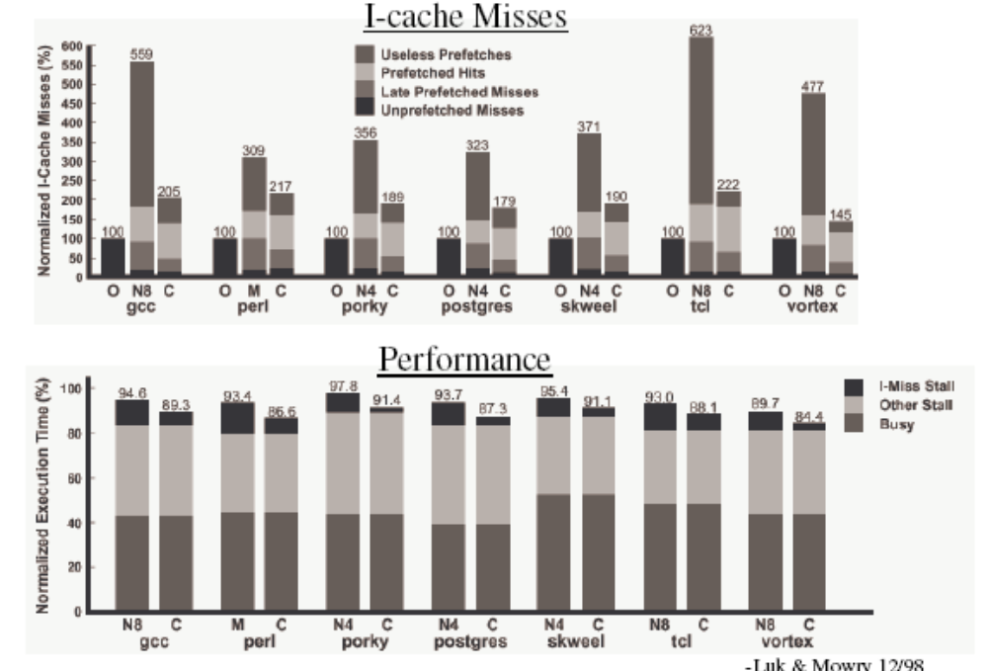
Results

Slide 73
More on pointer prefetching

Slide 74
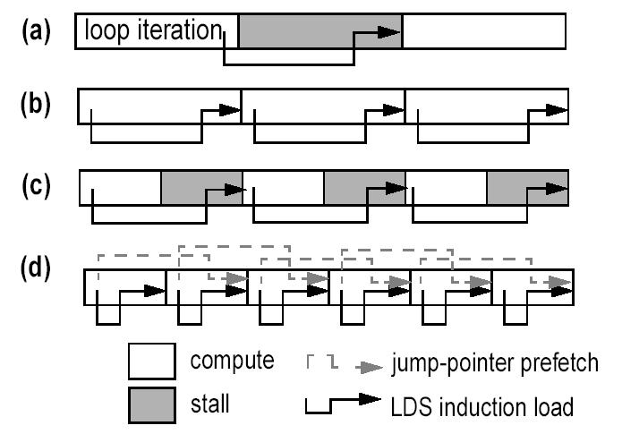
Jump Pointers – Roth’99

Slide 75
Jump Pointers – Roth’99
Jump Pointers are introduced to insert prefetches early enough to hide memory latency
  Profiling -> find hot spots
  Choose prefetch idiom by studying source code
  Insert the prefetching by hand
  Human work: one hour per bench (Olden)

Slide 76
Jump Pointers – Roth’99
Additional storage requirements
  History pointers are added into the data structure
  Could be offset by padding allocators
Code modification by hand
  Large programs?
No benefit from first traversal
  Installing/Creating jump pointers.

Slide 77
Hot Data Stream – Chilimbi’02
Hot Data Stream
  Data reference sequences that frequently repeat in the same order
  They account for around 90% of program references and more than 80% cache misses.
Hot data streams can be prefetched accurately since they repeat frequently in the same order.

Slide 78
Hot Data Stream – Chilimbi’02
Example:
  Given a hot data stream
  abacdce
  If we find a sequence of (prefix)
  aba
  Prefetches are inserted for
  c, d, e
  Deterministic finite state machine is used to do prefix-matching.

Slide 79
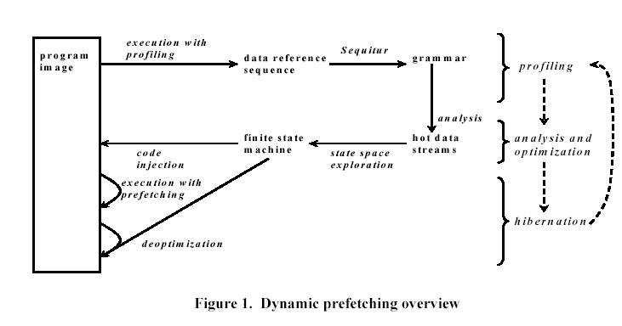
Hot Data Stream – Chilimbi’02

Slide 80
Stride Prefetching in Pointers
Discover regular stride patterns in irregular programs.
Y. Wu – PLDI’02, ICCC’02
Luk et. al. – ICS’02
  (Profiling based)
Inagaki et. al.– PLDI’03
  (Dynamic prefetching - Java)

Slide 81
Summary

Slide 82
Prefetching
Data Prefetching
  Prefetching for arrays vs. pointers
  Software-controlled vs. Hardware-controlled
Instruction Prefetching
Energy-Aware Prefetching

Slide 83
Prefetching in Other Areas
The idea of prefetching is widely used in other areas
  Internet: Web prefetching
  OS: Page prefetching, Disk prefetching
  Etc.

Slide 84
Reading Materials
Data prefetch mechanisms, Steven P. Vanderwiel, David J. Lilja, ACM Computing Surveys, Vol. 32 , Issue 2 (June 2000)

